Slide 1



Blazor Getting Started
R. Nambi
Senior Tech Lead

Slide 2
Client Side Framework
Silverlight
Blazor
Angular
React
Vue

Slide 3
What is blazor
Blazor is a framework for building interactive client-side web UI with .NET:
Create rich interactive UIs using C# instead of JavaScript.
Share server-side and client-side app logic written in .NET.
Render the UI as HTML and CSS for wide browser support, including mobile browsers.
Integrate with modern hosting platforms, such as Docker.

Slide 4
Advantage
Write code in C# instead of JavaScript.
Leverage the existing .NET ecosystem of .NET libraries.
Share app logic across server and client.
Benefit from .NET's performance, reliability, and security.
Stay productive with Visual Studio on Windows, Linux, and macOS.
Build on a common set of languages, frameworks, and tools that are stable, feature-rich, and easy to use.
PWA, Mobile Apps, Windows apps

Slide 5
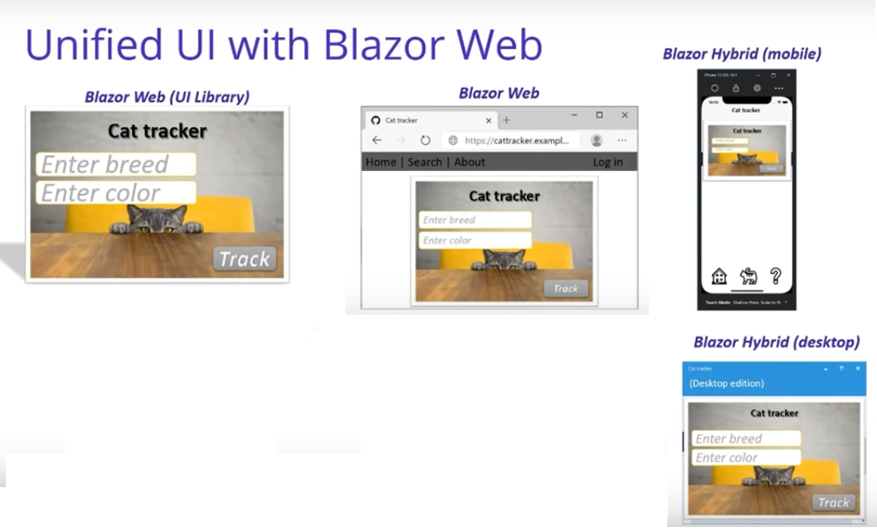
Notes:
https://docs.microsoft.com/en-us/mobile-blazor-bindings/
https://docs.microsoft.com/en-us/aspnet/core/blazor/progressive-web-app?view=aspnetcore-6.0&tabs=visual-studio

Slide 6
Project Types
Blazor Server
Blazor web assembly

Slide 7
Blazor Server
Blazor code hosted in server.
Code executes in server, the page (partial page) is sent to client using SignalR.
JavaScript interop
C# code can easily call JavaScript APIs and libraries.
So we can continue to use the large ecosystem of JavaScript libraries that exist for client side UI while writing your logic in C#.
When using server-side code execution, Blazor takes care of seamlessly executing any JavaScript code on the client.

Slide 8
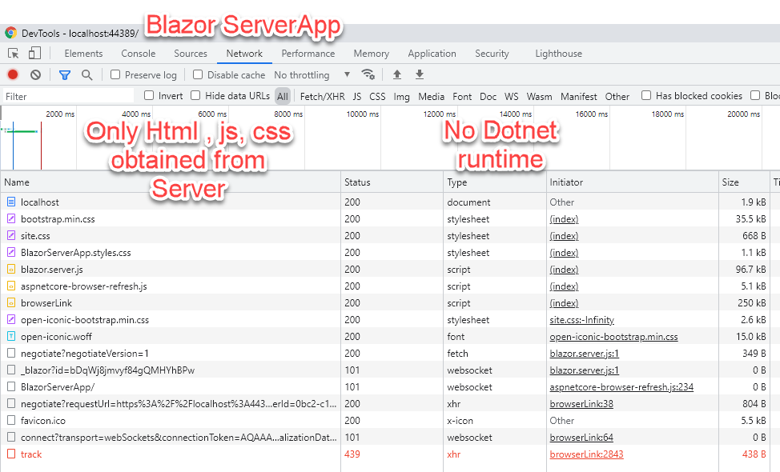
Blazor Server Files

Slide 9
Blazor webassembly
C# code can be run in browser using webassembly.

Slide 10
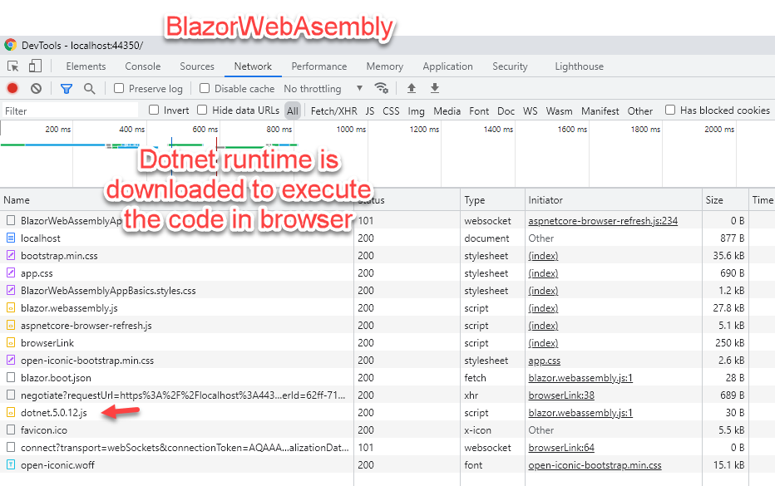
Blazor WebAssembly Files

Slide 11
Terms
-Components (Pages)

Slide 12
Code Structure- Code behind and UI
Option1: C# Code in the same razor file.
Option2: Have the base class.
Option3: Have the partial class.

Slide 13
Coding
Route- Path
File extension is .razor
Query String/Parameter
Binding/two way data binding
onclick

Slide 14
How Blazor Code is different from MVC
Dependency Injection
Assigning Default values through Startup.cs
Passing values in Query string parameters
Data binding

Slide 15
Links
PWA:
https://docs.microsoft.com/en-us/aspnet/core/blazor/progressive-web-app?view=aspnetcore-6.0&tabs=visual-studio
Mobile apps:
https://docs.microsoft.com/en-us/mobile-blazor-bindings/
Blazor
https://www.pragimtech.com/blog/blazor/what-is-blazor/
https://blazor-university.com/dependency-injection/injecting-dependencies-into-blazor-components/

